Slide 1



’’’
Practice coding with Code Clash!
’’’
while coding == True:
complete_tasks
practice_your_skills
compete_with_your_friends
Complete tasks
--> Try a new timed coding challenge task every day
Practice your skills
--> Improve your coding through practice
Compete with your friends
--> Code quickly to reach the
top of the leaderboard

Slide 2
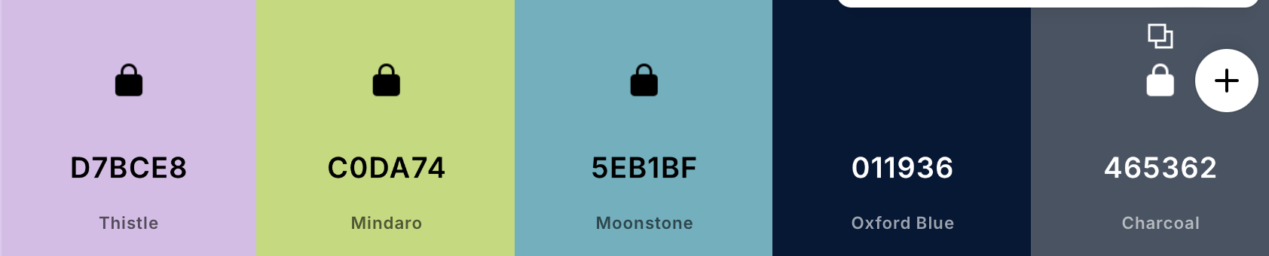
Colour scheme and logo
E88D58
216382

